Slide 1
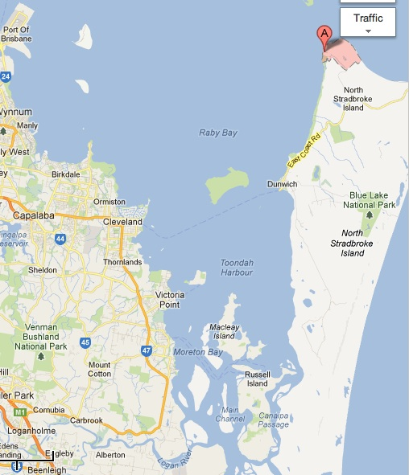
Amity Point
Wellington Point

